Slide 1
Weekly Report
2016741012 문석준
2017741021 김태겸
2017741025 장재우
2017741052 최석원
Mar 14, 2022

Slide 2
Index
1
Team Introduction
2
Project Concept
3
System Architecture
4
Schedule

Slide 3

Team Introduction
광역딜
광범위 영역을 타깃으로 하는 모바일 로봇을 제작하는 것이 주 목표
Advisor
Junghyun Oh, Ph.D.

Slide 4


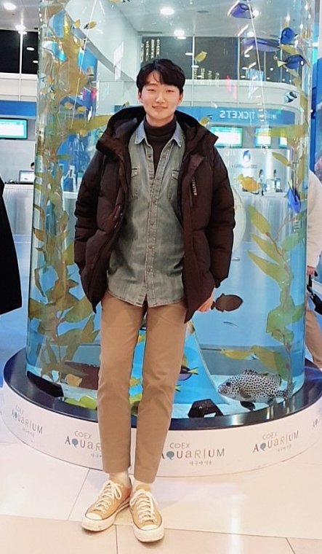
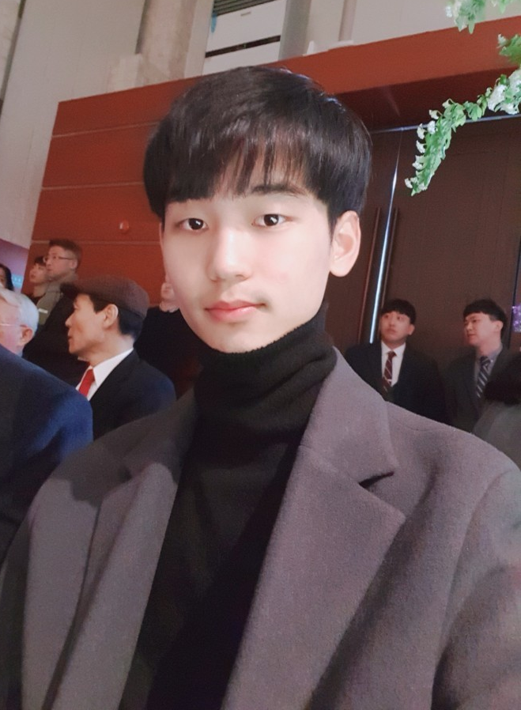
Team Introduction
Member
Jaewoo Jang
Team leader, Motor Control
Taegyeom Gim
Hardware Design
Seokwon Choi
SLAM
Seokjun Moon
Detection

Slide 5
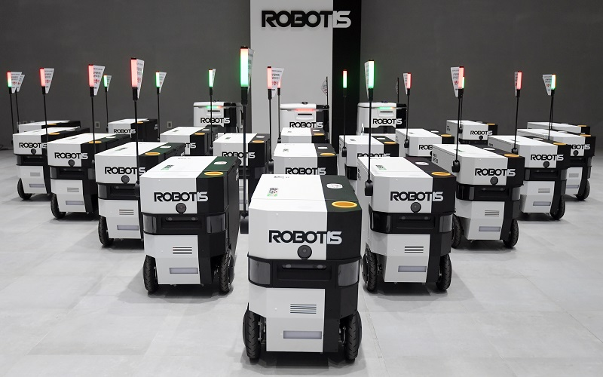
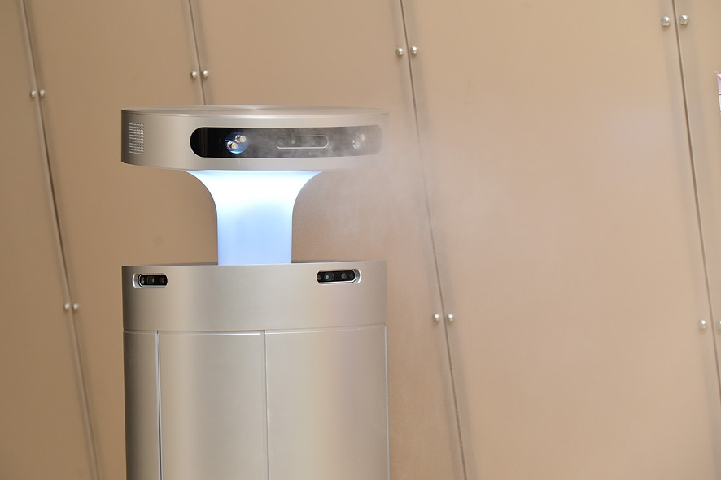
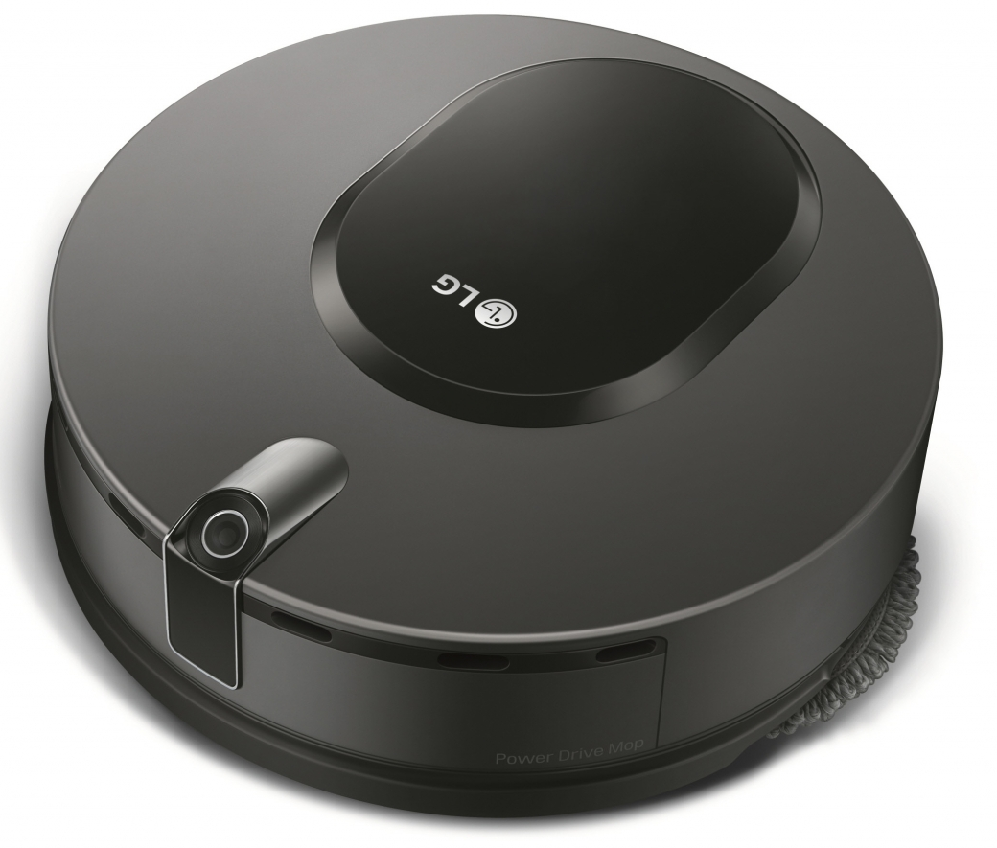
Project Concept
Problem about existing robots
One robot, one purpose
Fixed hardware, low adaptability

Slide 6
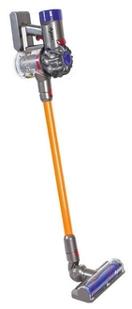
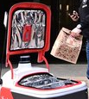
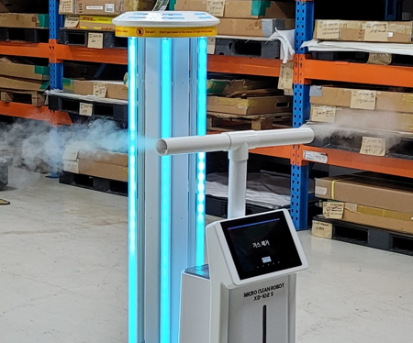
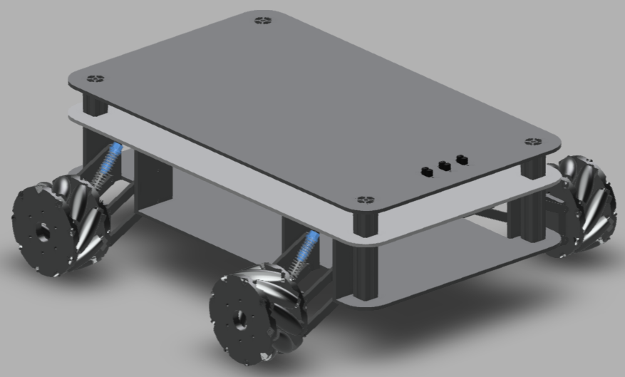
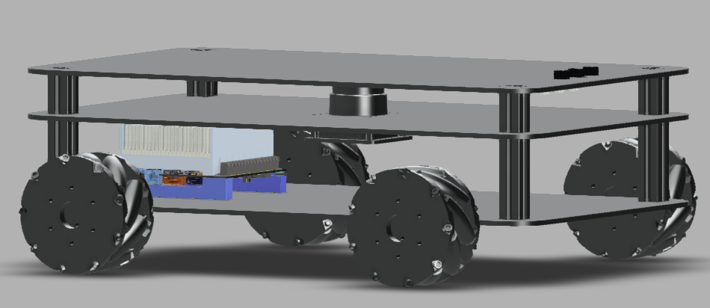
Project Concept
Proposal
One robot, many possibility
Changeable hardware, high adaptability
Robot platform + modules

Slide 7
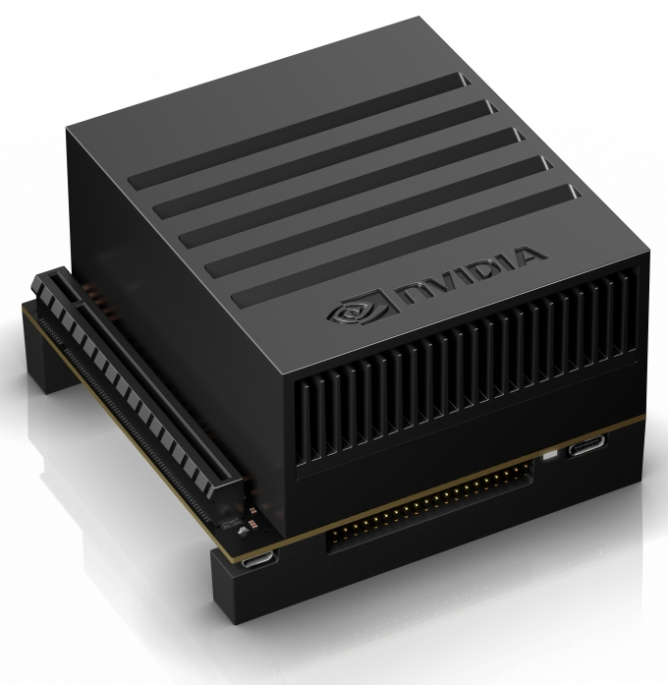
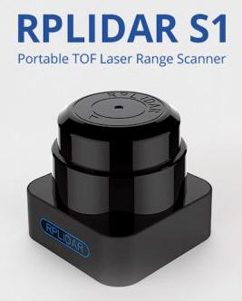
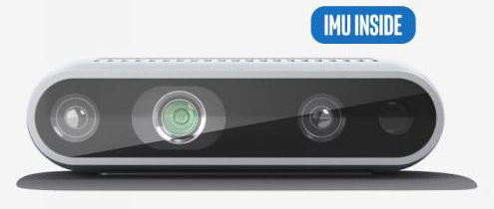
Project Concept
Robot platform
Jetson AGX Xavier
Powerful GPU performance, fast computational processing power
LiDAR + Depth camera
SLAM & Detection based autonomous actions

Slide 8

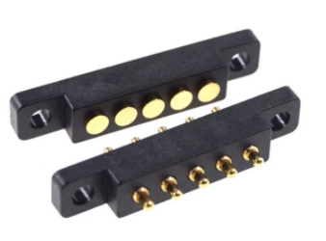
Project Concept
Robot platform
Mecanum wheels
Move in all directions easily
Easy to connect modules
Use the limit switch to find out what module is connected
Power supply to the module using magnetic cable

Slide 9
Project Concept
Modules
Delivery
Get user input by GUI
Localization & navigation to the goal
Disinfection
Move around and detect door & doorknob
Spray disinfectant to doorknob
Cleaning
Global exploration based on wall following algorithm
Cleaning floor

Slide 10
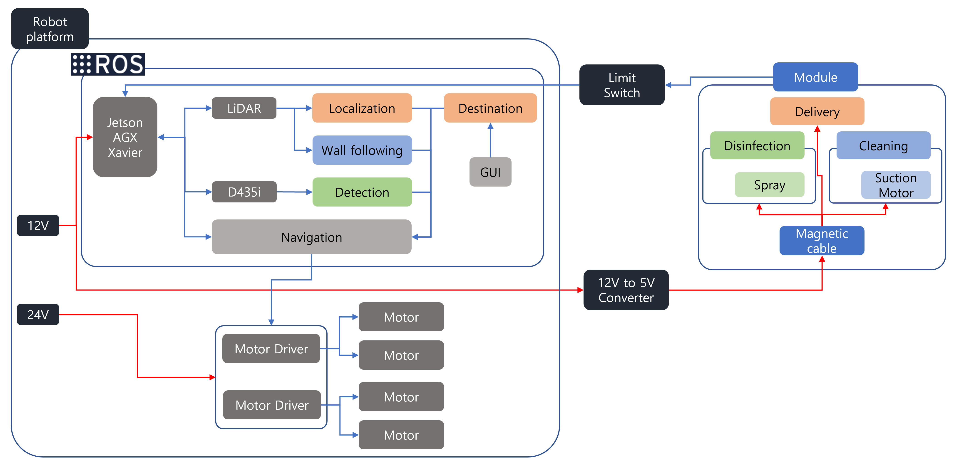
System Architecture

Slide 11
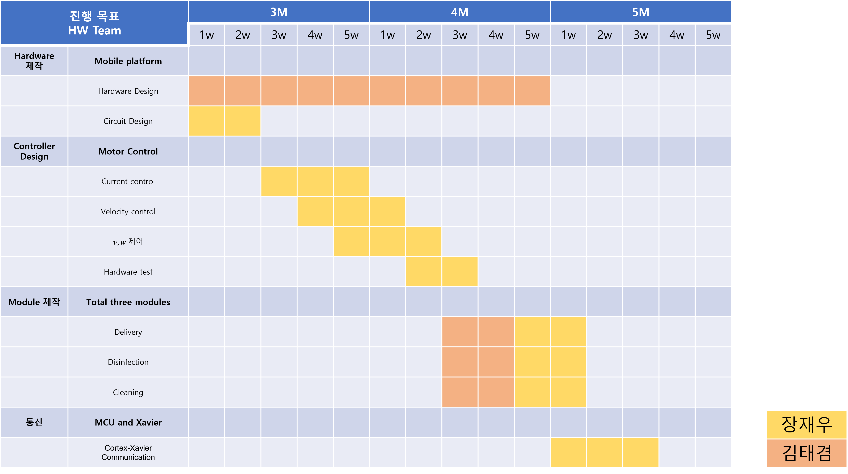
Schedule - HW

Slide 12
Schedule - SW

Slide 13
Q&A
Thank you

